Slide 1

Stage 6 Changing Up The Norm Course Designer: Marcel Englmaier
Changing Up The Norm is a 20 round, 100 point Comstock Long Course. There are 10 IPSC targets. The best two hits per target will score. The start and stop signal are audible.
The Handgun start position is standing with toes touching Xs and wrists below belt. Handgun is loaded and holstered. The PCC start position is standing with toes touching Xs both hands grasping PCC. PCC is loaded with safety on and stock on belt, muzzle pointed down range.
On the audible start signal, engage all targets from behind the fault line. All barrels are soft cover.

Slide 2
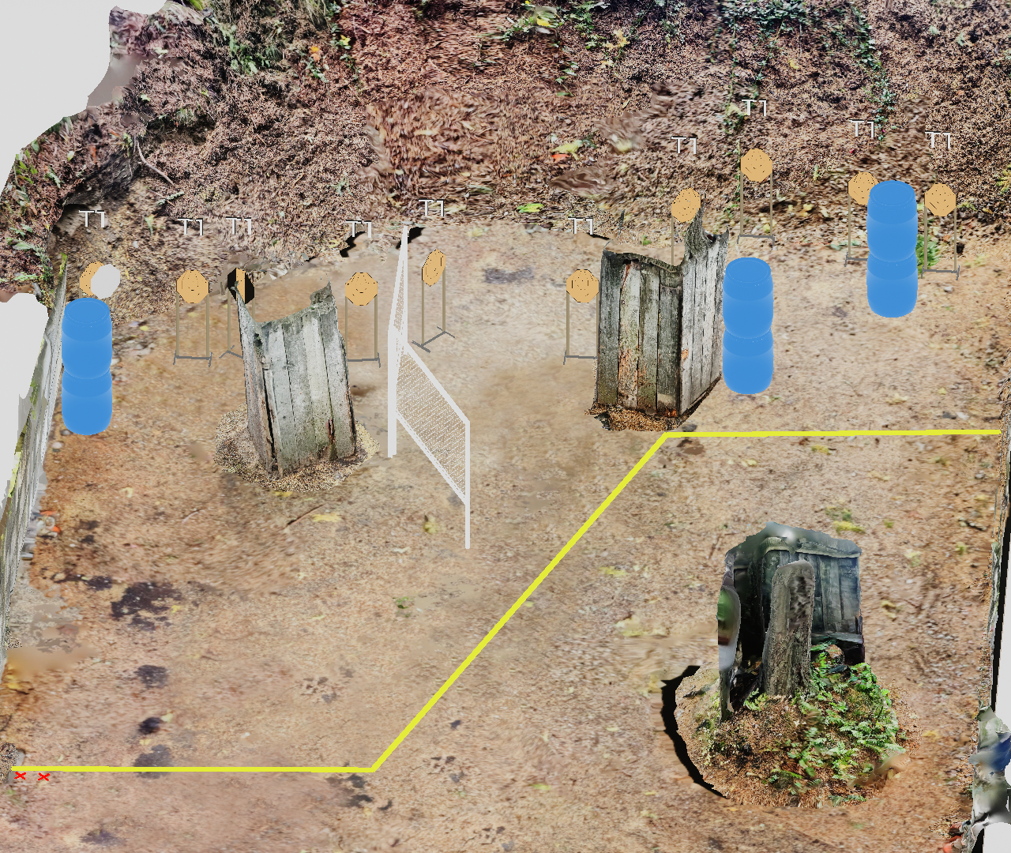
 | Stage 6 Changing Up The Norm Course Designer: Marcel Englmaier

